Slide 1

Data Analytics & Architecture
Semantic Layer Strategy and Maturity
August 2022

Slide 2
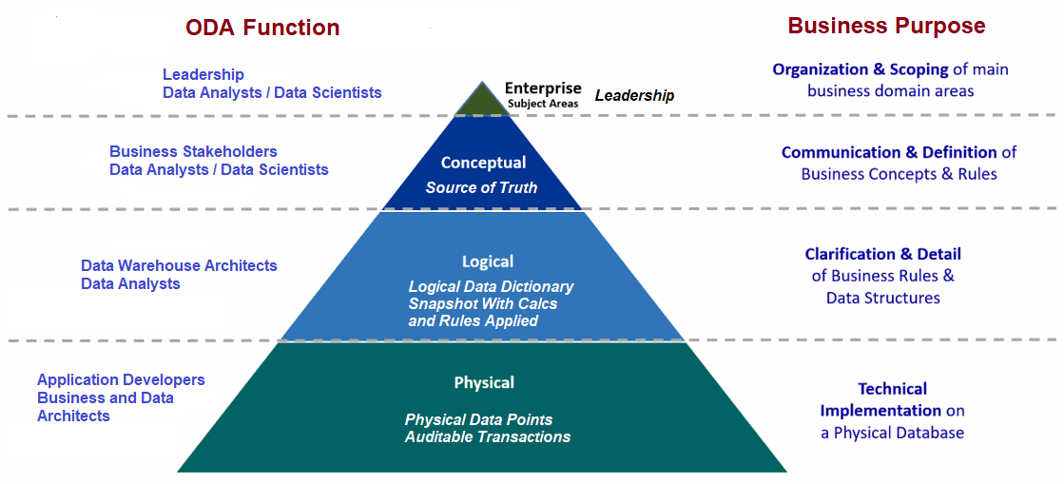
Modern Data Analytics and Semantic Layers
A semantic layer translates technical metadata into friendlier business metadata.
Notes:
Levels 4-1 is what I call these. Level 1 being executive level.
Level 4 is the raw data level.
Level 3 is the data curation level and is critical to self-service reporting
Level 2 is the data modeling level and is critical to predictive and trending operational perspectives.
Level 1 is the visionary level and it brings leadership perspectives and changes into the view of possibilities.

Slide 3
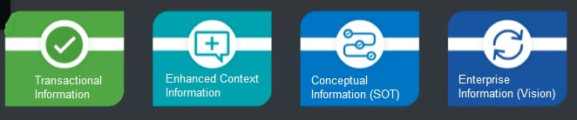
Why have semantic layers?
▶ Well defined and understood data drives insights
▶ Data democratization and governance
The need for data definition and data literacy has reached a critical level due to TSTC application integrations happening at an unprecedented rate and our rapid business changes. TSTC is demanding business analytics at faster speeds and with more external data sources. Semantics helps us meet these needs at different levels of the business.
Notes:
One of the key principles of data analytics is that the quality of the analysis is dependent on the quality of the information analysed.
Gartner estimates that more than 25% of critical data in the world’s top companies is flawed (Gartner 2007).

Slide 4
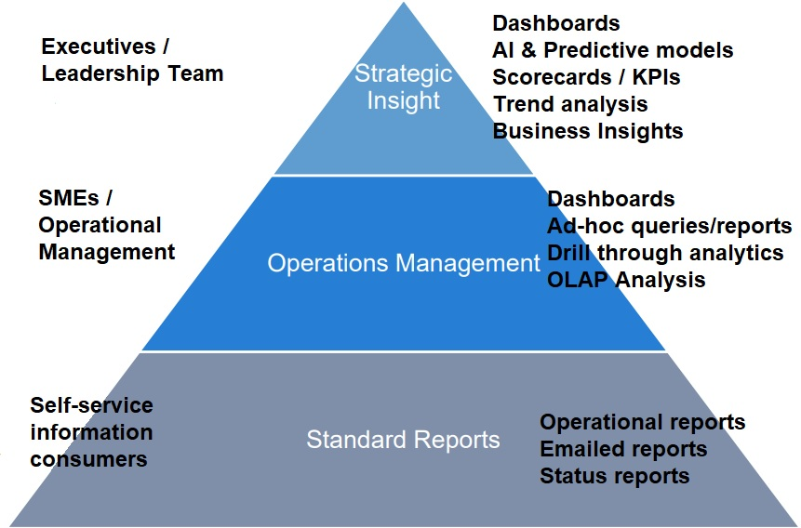
Who are the BI Consumers at each semantic level?
Level 1
Data Asset Value and ROI
Level 2
Level 3
Notes:
Level 3 Data curation provides the methodological and technological data management support to address data quality issues maximizing the usability of the data.
The core impact of data curation is to enable more complete and high-quality data-driven models for knowledge organizations with self-service reporting.
Crowdsourcing : Data curation can be a resource-intensive and complex task, which can easily exceed the capacity of a single individual.
Level 2 Data modelling and Common Data Modelling (CDM) enable the simultaneous analysis of disparate data sources.
The analytical models from data mining and computer science heuristics help in analysis and visualization of data, predicting student performance, generating recommendations for students as well as teachers, providing feedback to students, identifying related courses, e-content and books, detecting undesirable student behaviors and developing course content.
Level 1 Predictive Data Modelling. Uses high-dimensional semantic vectors derived from large-scale datasets like social media or Google or web scraping and applies machine learning techniques to map these vectors onto leadership change effectiveness.

Slide 5




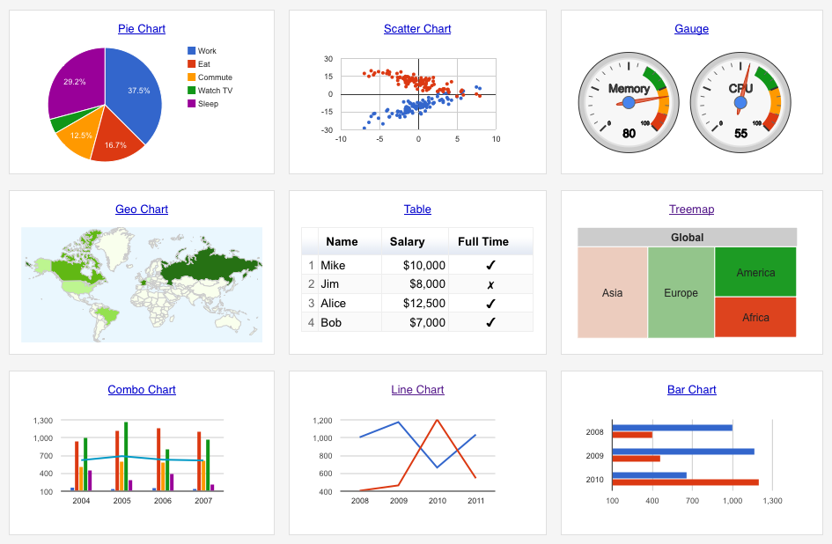


Level 3 semantic layer - Headless BI
DAX
SQL
MDX
Python
Notes:
▶ A Business Analytics platform – BI tool agnostic
BI tools are continuously evolving, so it’s important to take a long-term investment view and avoid vendor lock-in of the semantic layer.

Slide 6
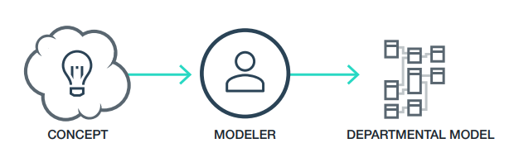
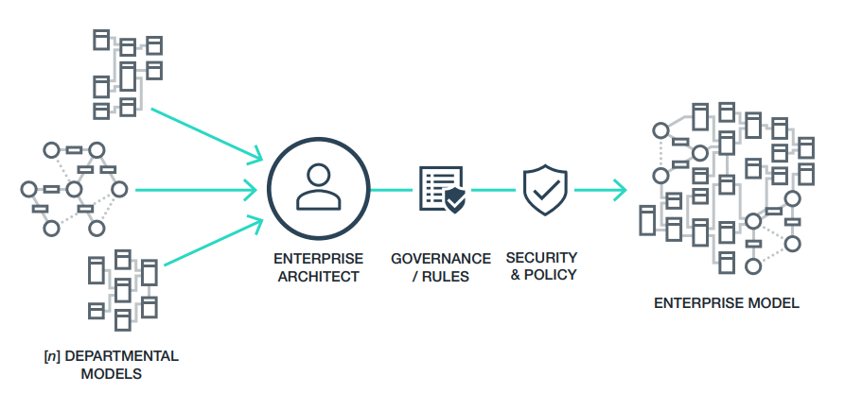
Level 2 data modelling - “model of models”
▶ The Enterprise Entity – the entities to model must be crafted from a collection of other previously modeled entities as opposed to “modeling them from scratch.”
Notes:
The ability to make inferences about data and complex relationships via rule sets.
For example, we might create rules such that when two facts are true (or two relationships exist), we may infer that a third fact or relationship exists without it being explicitly encoded in the data.

Slide 7
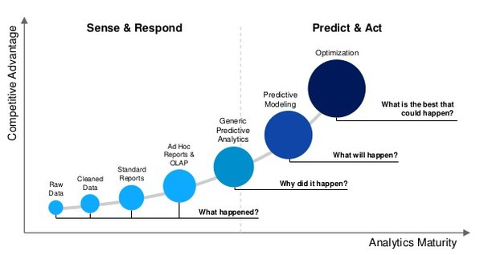
Level 1 strategic modelling.
▶ Predictive models and Explanatory Models and Computational models.
Notes:
When building multivariate statistical models, researchers need to be clear as to whether their goals are explanatory or predictive.
Explanatory research aims to identify risk (or protective) factors that are causally related to an outcome.
Predictive research aims to find the combination of factors that best predicts a current diagnosis or future event.
This distinction affects every aspect of model building and evaluation.

Slide 8
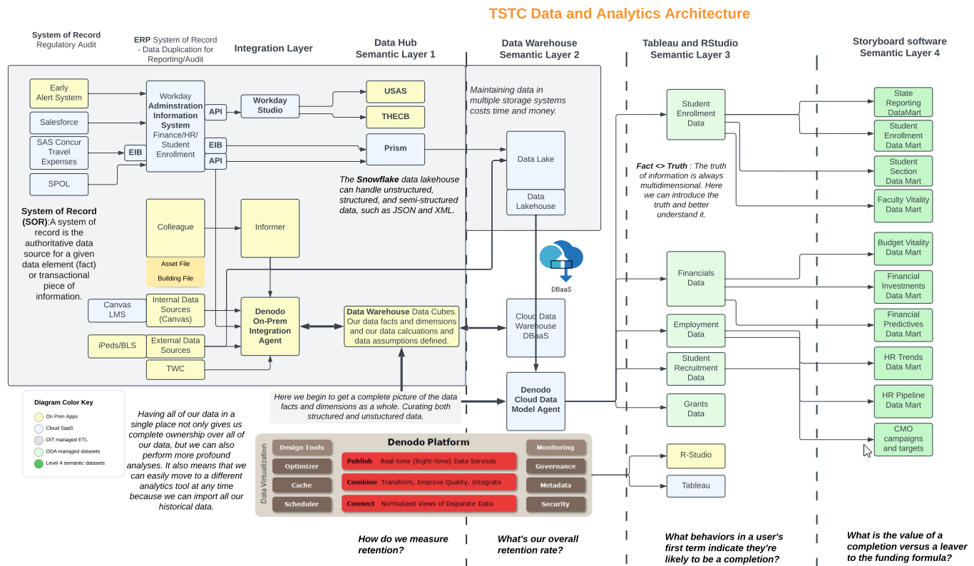
How does our architecture support our Semantic Layers?
Notes:
One of the key principles of data analytics is that the quality of the analysis is dependent on the quality of the information analysed.
Gartner estimates that more than 25% of critical data in the world’s top companies is flawed (Gartner 2007).

Slide 9
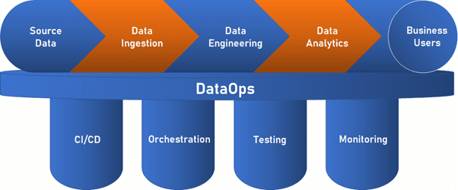
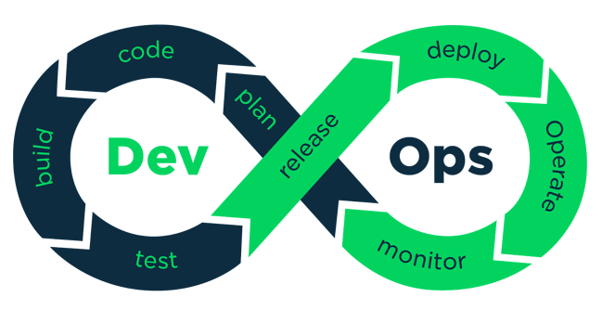
What is DevOPs and DataOps and why should we use them?
Outcome
The goal of DataOps is to reduce the cost of data management, improve data quality, and deliver insights to analysts and business users faster by creating data pipelines.
DataOps and DevOps are built on breaking down silos between teams.
DevOps closely parallels the agile development methodology. the development team isn't solely concerned with delivering the product but how it performs after deployment as well. Its benefits include increased communication between the product teams, cost savings, constant improvement, and quick implementation of customer feedback.
Notes:
DataOps is achieved through several methods, including automating manual data collection and analysis methods, increasing reusability, democratizing access to data, and continuously monitoring the data pipeline.
DataOps connects stakeholders from across the organization with data engineers, data scientists, analysts, and IT to determine which metrics are valuable for creating business intelligence. The DataOps team then determines which data sets are relevant, which technologies can extract the data, and how to transform and analyze the retrieved data.
DevOps and DataOps are extensions of the agile development methodology to their respective domains: software development and data analysis.
Both methods use short iterative cycles to quickly produce results and collect feedback from stakeholders to inform their next steps.

Slide 10
DataOps vs. DevOps: The Differences.
DataOps is focused on creating data streams that constantly deliver data and produce information for end users. This process may involve building applications for transforming and displaying data or may focus more on optimizing existing infrastructure.
Outcomes
DevOps is focused on quickly delivering valuable software to customers through fast deployments and iterative improvements that are guided by customer feedback. This process involves delivering a minimally viable product (MVP) as soon as possible and expanding its functionality over subsequent development cycles.
DataOps is used to stream data to those who need it to inform their decisions. This means that the DataOps team is constantly working to ensure the pipeline is still delivering the best data. DataOps pipeline is all about speed. Moving and transforming new data as soon as it's collected.
Workflow
DevOps is also meant to move quickly, but each piece of the DevOps pipeline still happens in defined stages.

Slide 11
DataOps and DevOps together enable agile organizations.
In DataOps, the true statistic isn't always known, so test results need to be validated for correctness. Never sure if their test is successful and always questioning the results.
Testing
In DevOps, outcomes are defined and expected, so the testing phase is straightforward.
DataOps places a higher emphasis on feedback from business users and analysts to determine if the deliverable meets their needs.
Feedback
DevOps does not necessarily require feedback from the customer unless an aspect of the application is not meeting their needs. If the end user is happy with the delivered product, then their feedback is voluntary.
Together, these concepts build and streamline the development and data pipelines to deliver valuable software and insights to the end user faster. By following the agile method of constant collaboration, incremental improvement, and a focus on feedback, they support your internal teams and your customers.
Notes:
DataOps and DevOps are built on breaking down silos between teams.

